Slide 1
信号分析及处理
熊继平
xjping@zjnu.cn
660052

Slide 2
课程讨论对象
稀疏信号（Sparse Signal）

Slide 3
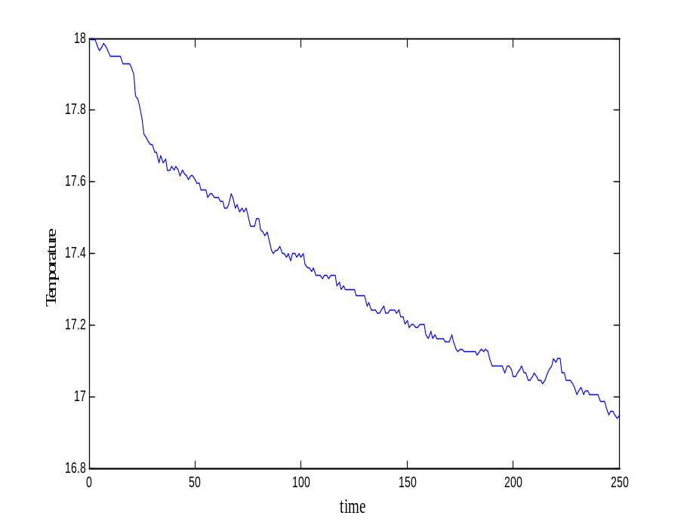
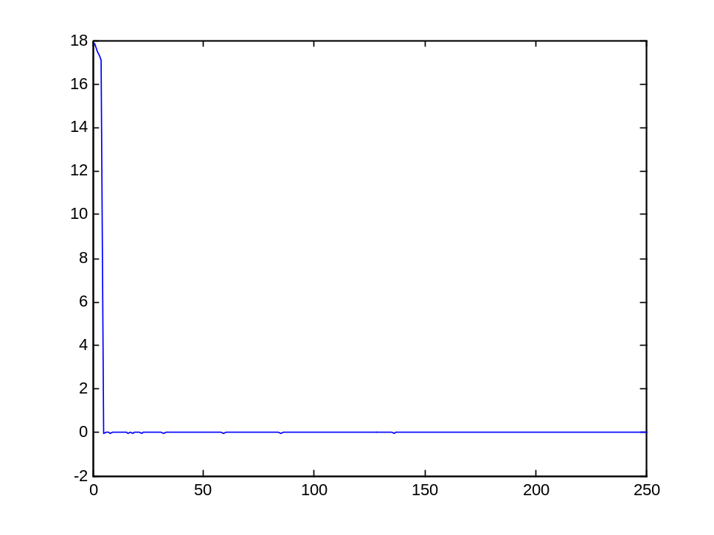
Sparsity or Compressible of
Natural Signal
Basic of Compressive Sensing
Temperature measurement of one sensor
Coefficients of DCT transform

Slide 4
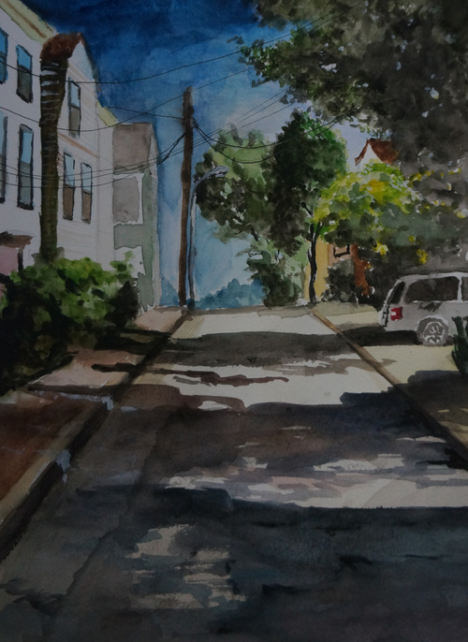
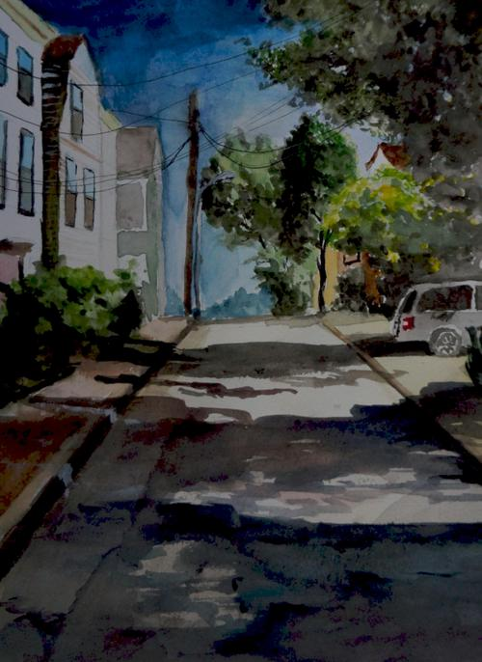
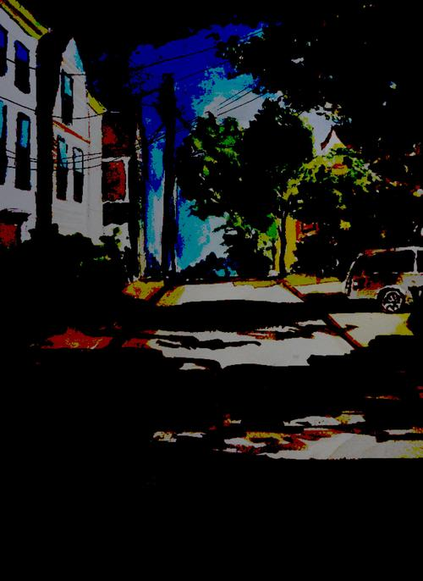


Sparsity or Compressible of
Natural Signal
Basic of Compressive Sensing
Those kind of signals are so-called k-sparse signal in a certain transform basis

Slide 5
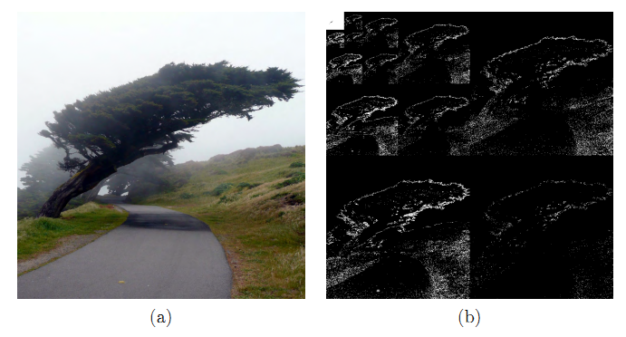
Sparse in wavelet-domain
Sparse representation of an image via a multiscale wavelet transform.
(a) Original image. (b) Wavelet representation. Large coefficients are represented by light pixels, while small coefficients are represented by dark pixels. Observe that most of the wavelet coefficients are close to zero.

Slide 6
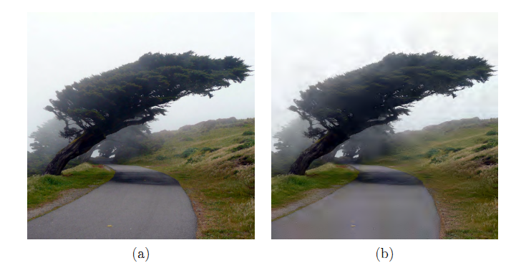
Sparse in wavelet-domain
Sparse approximation of a natural image.
(a) Original image.(b) Approximation of image obtained by keeping only the largest 10% of the wavelet coefficients.

Slide 7
课程主要内容
压缩感知(Compressive Sensing,CS)理论及应用
压缩感知各类重构算法
凸优化
矩阵恢复（Matrix Completion,MC）理论及应用

Slide 8
课程考核方式
课堂表现
课堂报告
课程论文

Slide 9
相关资源
Rice大学收集的压缩感知相关资源
  http://dsp.rice.edu/cs
Igor压缩感知博客
  http://nuit-blanche.blogspot.jp/
最大交友网站
  https://www.github.com/
牛客网
  https://www.nowcoder.com/
力扣
  https://leetcode-cn.com/

Slide 10
课程网站
链接：
  https://github.com/wishgale/sparse

